Slide 1
Data Transformation

Slide 2
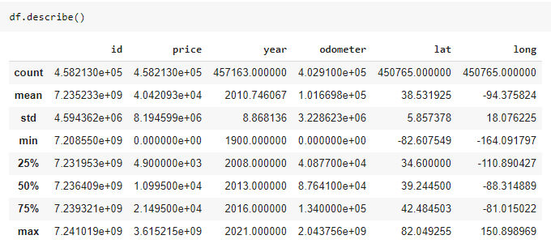
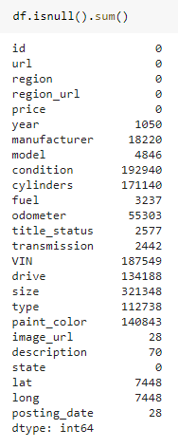
Dataset Quality Check
Invalid inputs (filter)
Price range: $100 - $200,000
Odometer: 10km – 200,000km
NAN values (drop or replace)
Mean values are in different scales (Standard Scaler)

Slide 3
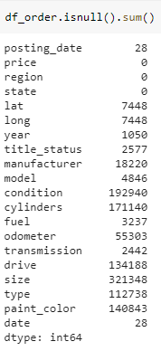
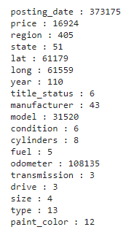
Dataset Transformation
Steps:
1/ Filter out price range and odometer range.
2/ Remove redundant columns.
Check unique values
3/ Check unique values of each column.
Notice: region has 405 unique values and model has 31520 unique values. (increase model complexity)

Slide 4

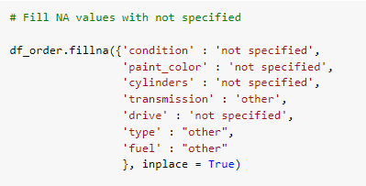
Dataset Transformation
Steps:
4/ Columns in red are important features in determining the price prediction. We drop all rows with NAN values in these columns.
5/ Columns in green, we replaced NAN values with ‘not specified’ or ‘other’ and make it another unique value for each feature. They will be kept in the model.

Slide 5
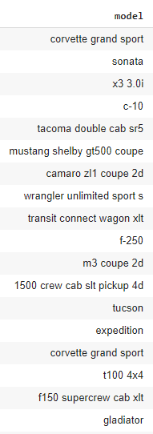



Dataset Transformation
Check unique values
6/ Only take car models that has more than 100 inputs
Reduce complexity of the column by 90x !

Slide 6
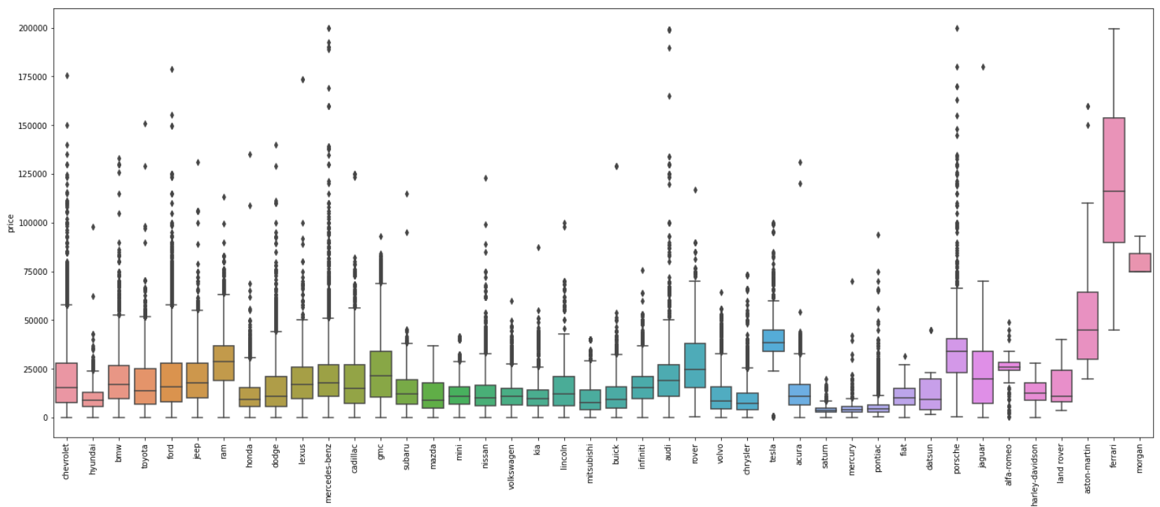
Check Outliers
Price vs. Manufacturer

Slide 7
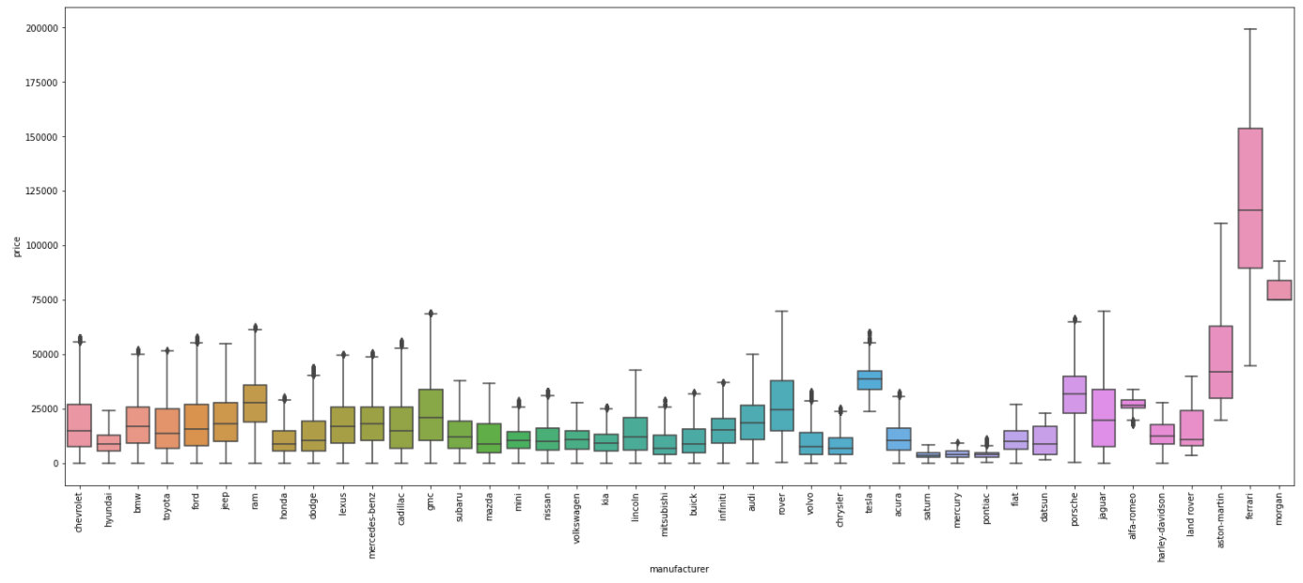
Check Outliers
Price vs. Manufacturer
7/ Remove outliers using interquartile range (IQR)

Slide 8
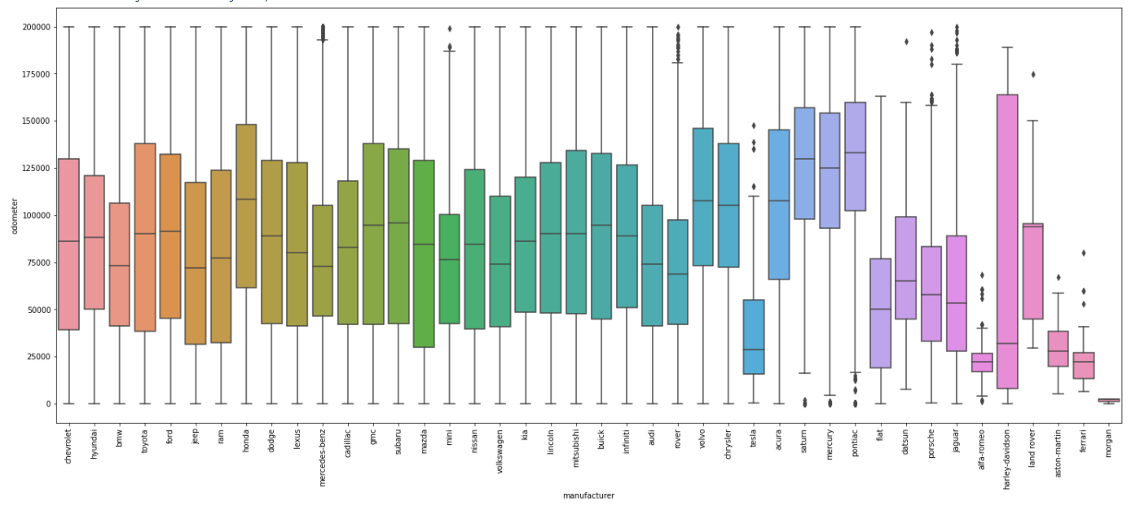
Check Outliers
Odometer vs. Manufacturer

Slide 9
Algorithms Comparison

Slide 10
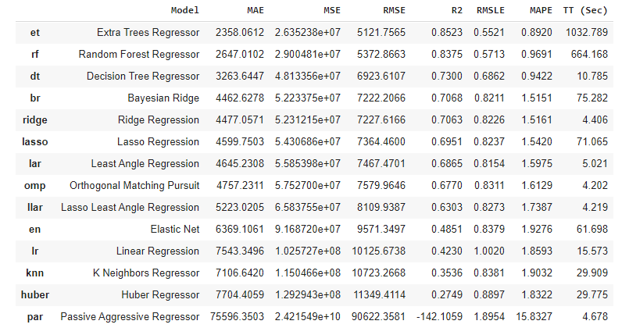
Regression Analysis with Pycaret
With limited computing resources that Colab allows, we only used 30% of the data set to run the model comparison function.
By default, Pycaret automatically split 30% of data for testing, and uses k-fold validation with k = 10.
Based on the results, we can expect that Random Forest Regressor will be a better fit than Linear Regression for our model.

Slide 11
Data Pre-processing
Get dummies for Categorical Features
Standard Scaler

Slide 12
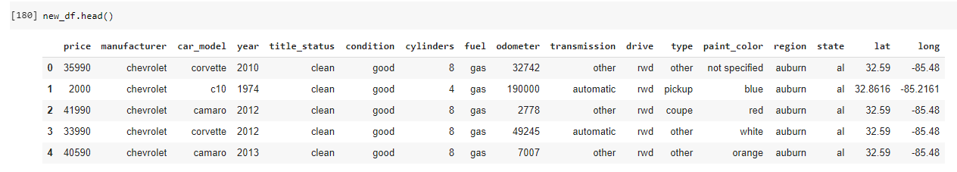
Get Dummies (Categorical)
11 Categorical Features
‘target’
5 Numerical Features

Slide 13
Further reduce model complexity
351 unique values
Clean, nan
405 unique values
Less impacts on car prices
Again, due to limited computing resources, further drop these columns during data pre-processing step to reduce model complexity.

Slide 14
Further reduce model complexity
Apply get_dummies to categorical features
Split dataset to train (70%) and test (30%)
Apply Standard Scaler to train and test data

Slide 15
Model Selection
Linear Regression and Hyperparameter Tuning Using Grid Search CV
Random Forest Regression

Slide 16
Further reduce model complexity
351 unique values
Clean, nan
405 unique values
Less impacts on car prices
Again, due to limited computing resources, further drop these columns during data pre-processing step to reduce model complexity.

Slide 17
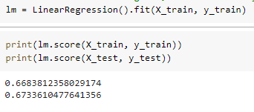
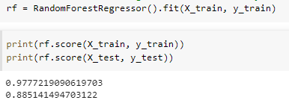
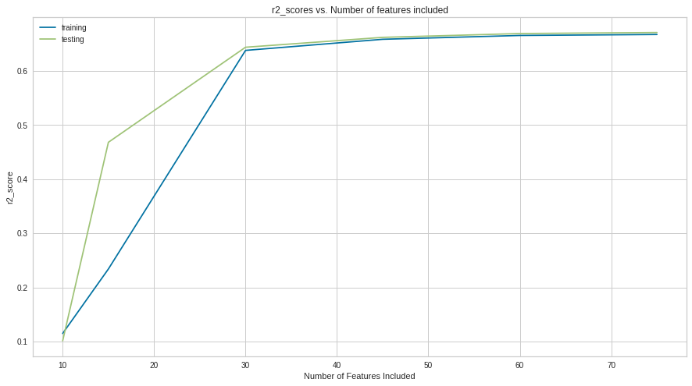
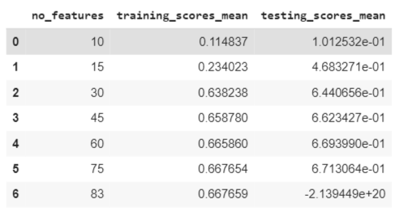
Multi-Linear Regression vs Random Forest Regression

Slide 18
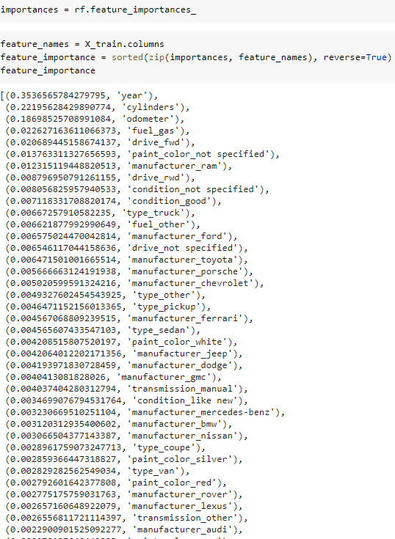
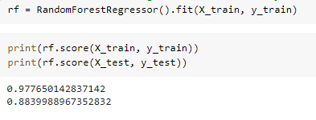
Random Forest & RFE

Slide 19
Future Works
When computing resources available, add back ‘model’ column to increase prediction accuracy
Further Feature Engineering Tasks to reduce the model complexity

